Slide 1
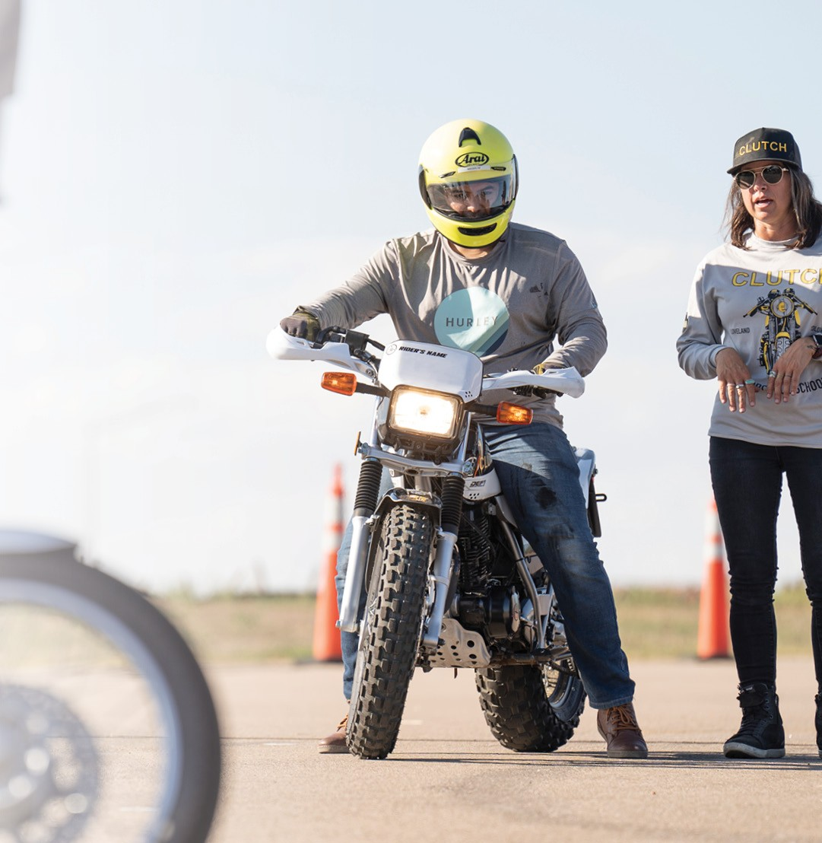
Take Your First Ride!
Ride a motorcycle in 30 minutes or less — for free!
Motorcycle, helmet, gloves, and coaching are provided.
Free Riding Skills Test
Take the challenge of an advanced MSF course!
Bring your motorcycle and gear!
Notes:
Replace image: Right Click/Change Picture>From a File
Adjust image cropping, positioning, and/or scaling: Right Click/Crop
Adjust image brightness settings: Right Click/Format Picture/Picture Corrections/Brightness & Contrast Slider
Replace text: Edit menu/Paste and Match Formatting option
Export post: Main Menu/File/Export/File Format>jpg
Post Size: 1080px x 1920px

