Slide 1
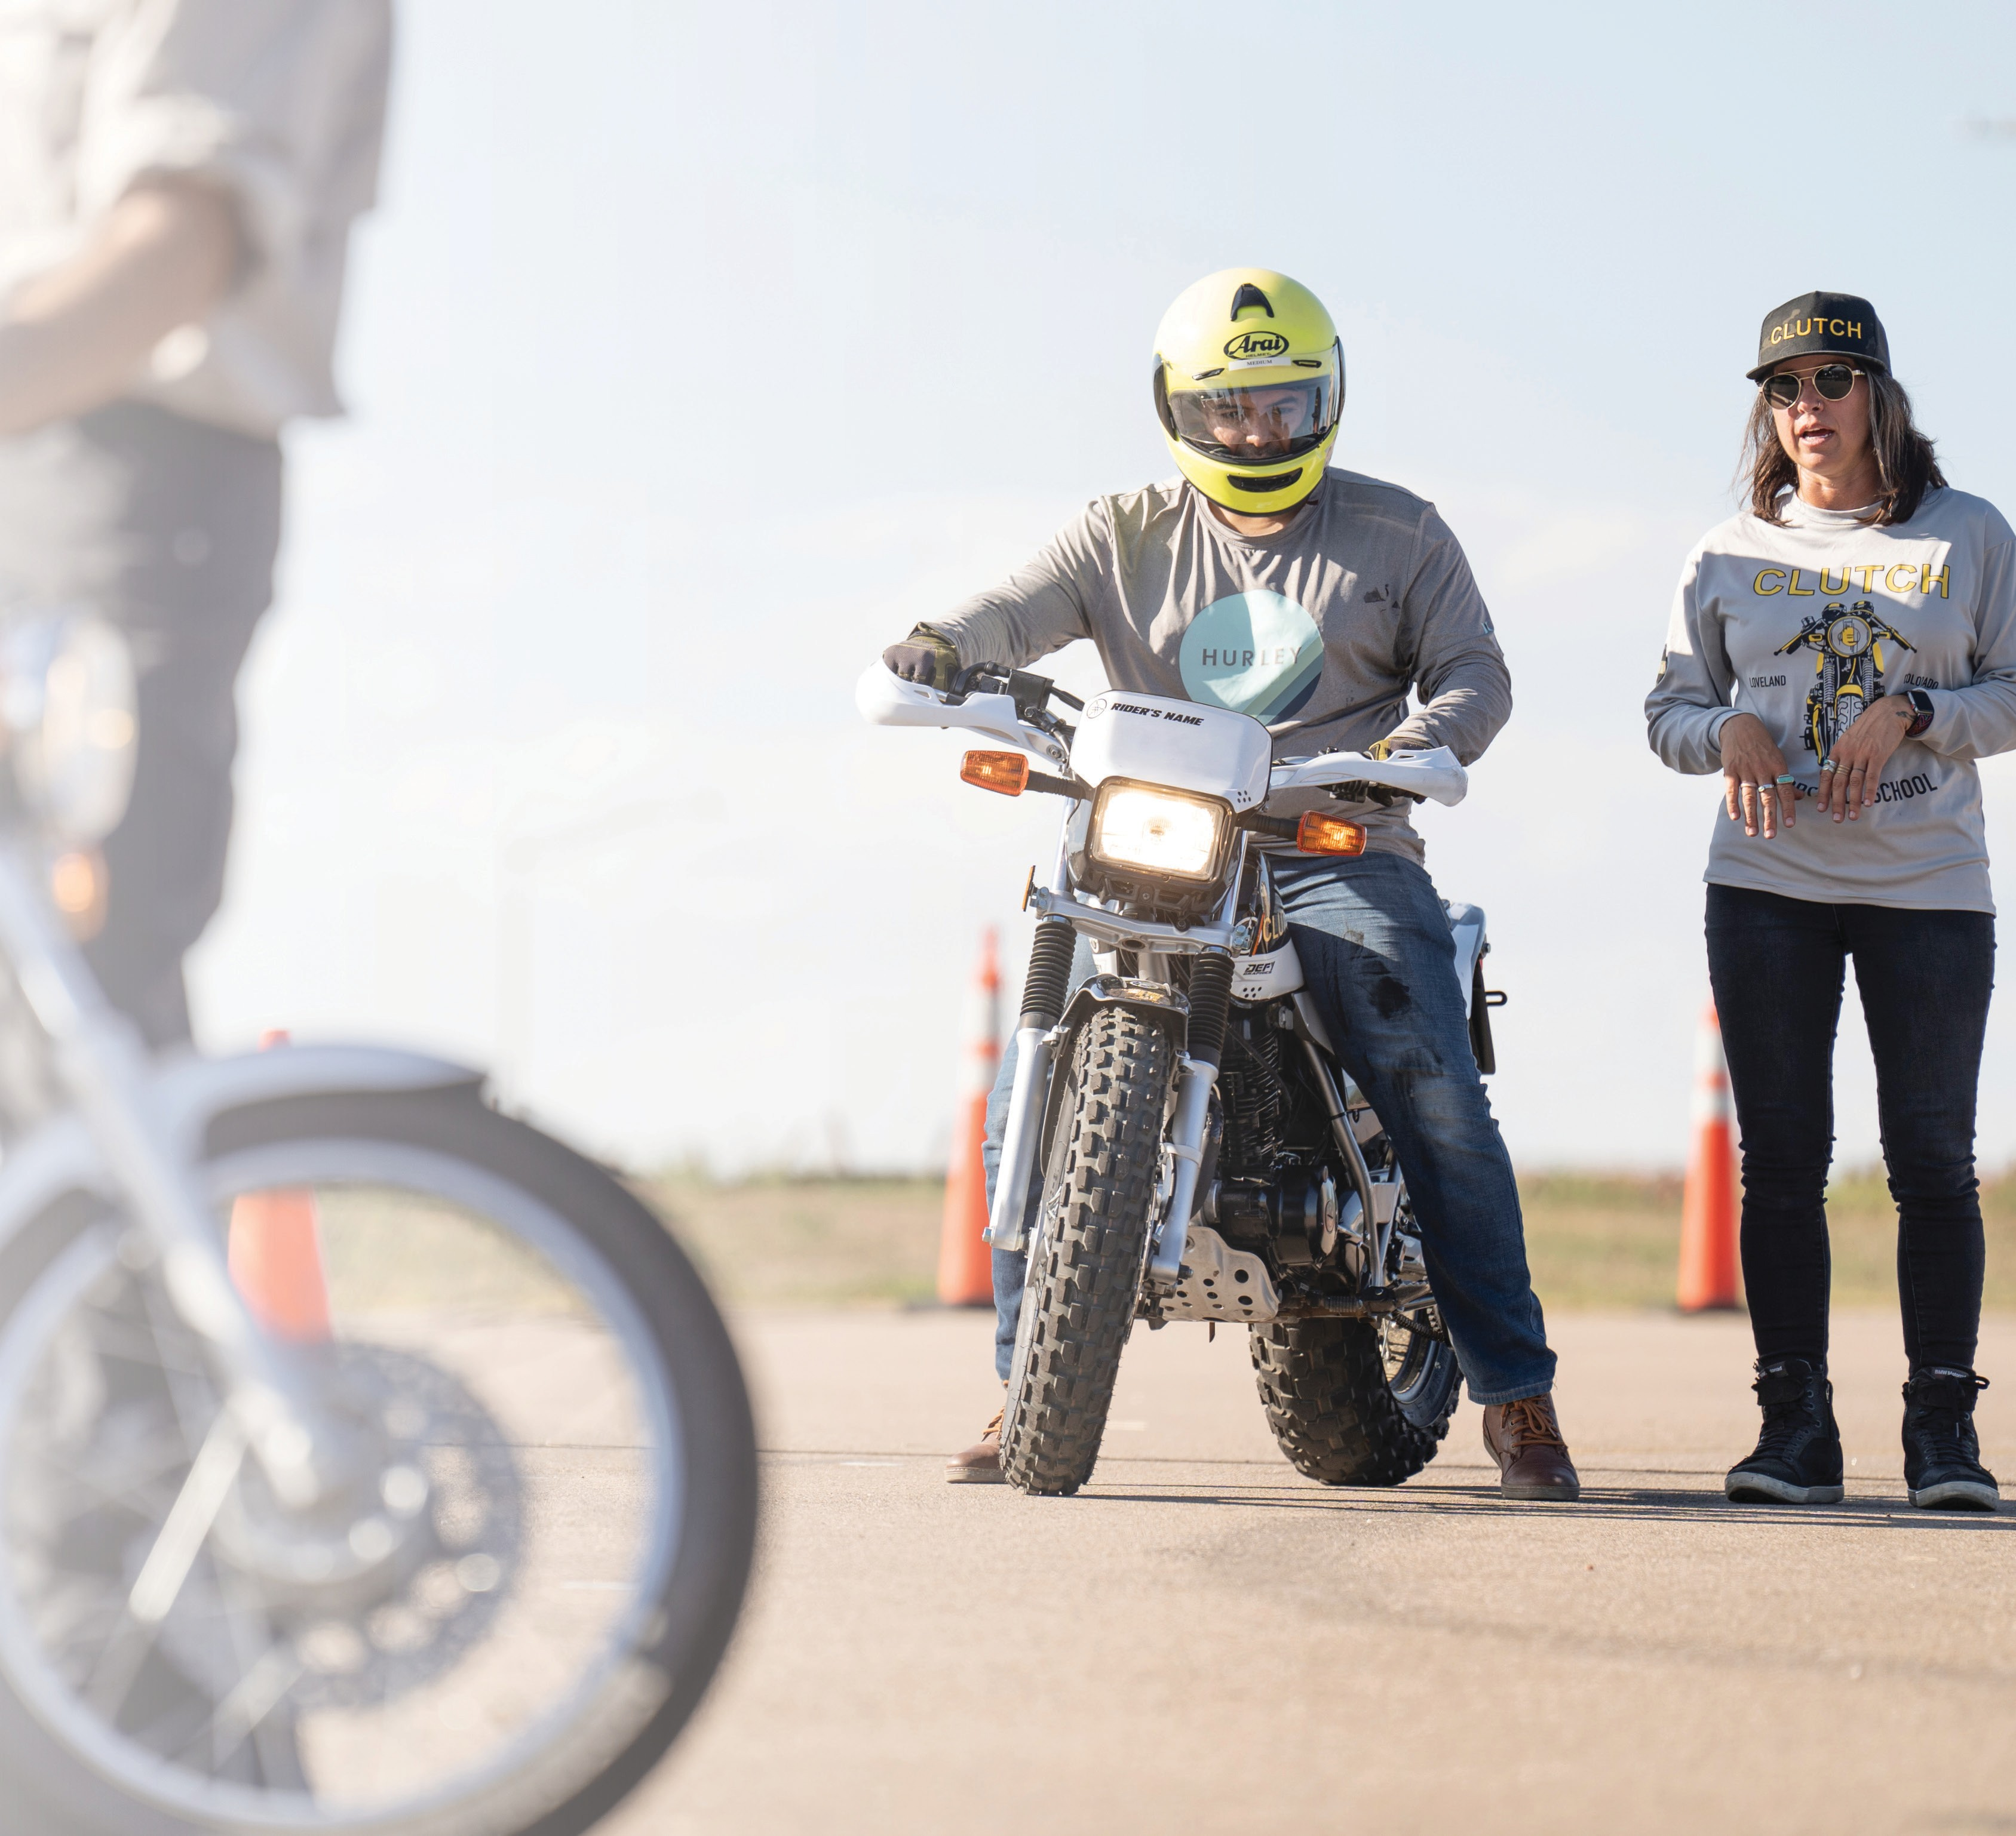
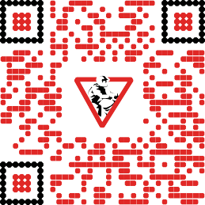
Take Your First Ride!
Ride a motorcycle in 30 minutes or less — for free!
Free Riding Skills Test Take the challenge of an advanced MSF course!
Learn more at msf-usa.org/RIDE-day
MOTO Intro provides the motorcycle, helmet, gloves, and coaching. Please wear over-the-ankle footwear, long pants and long sleeves. SKILLS Check participants, bring your motorcycle and gear!
Notes:
Replace image: Right Click/Change Picture>From a File
Adjust image cropping, positioning, and/or scaling: Right Click/Crop
Adjust image brightness settings: Right Click/Format Picture/Picture Corrections/Brightness & Contrast Slider
Replace text: Edit menu/Paste and Match Formatting option
Export as pdf

